Slide 1
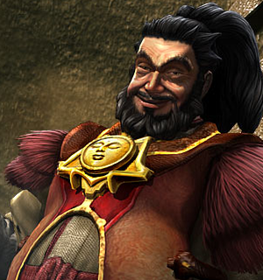
Team Bo Rai Cho
Space Fighter
JavaScript DOM&UI Team Project
Team members:
Liliya Lyubenova lilly12
Yanko Tsigularov Tsigularov
Ivaylo Georgiev IvayloGeorgiev
Vladimir Stefanov stefanov2081
Nikolay Dimitrov timenov
Telerik Software Academy
http://academy.telerik.com

Slide 2
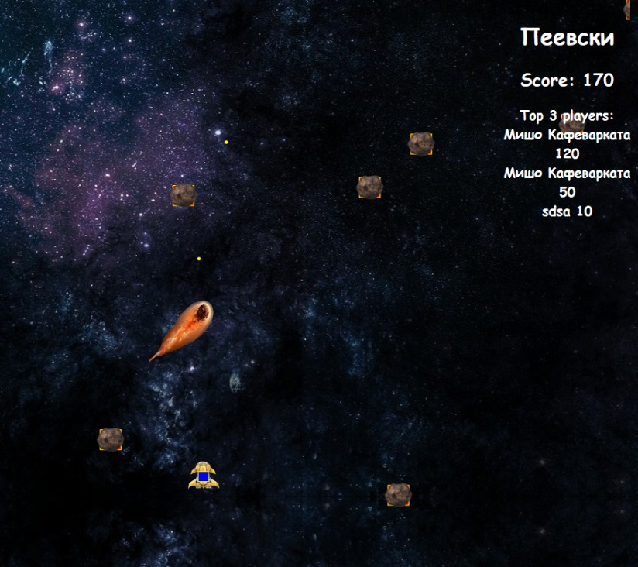

Gameplay
Main goals
Destroy the asteroids and collect points
Stay alive as long as possible
Game over
When commet or asteroid hit the ship

Slide 3
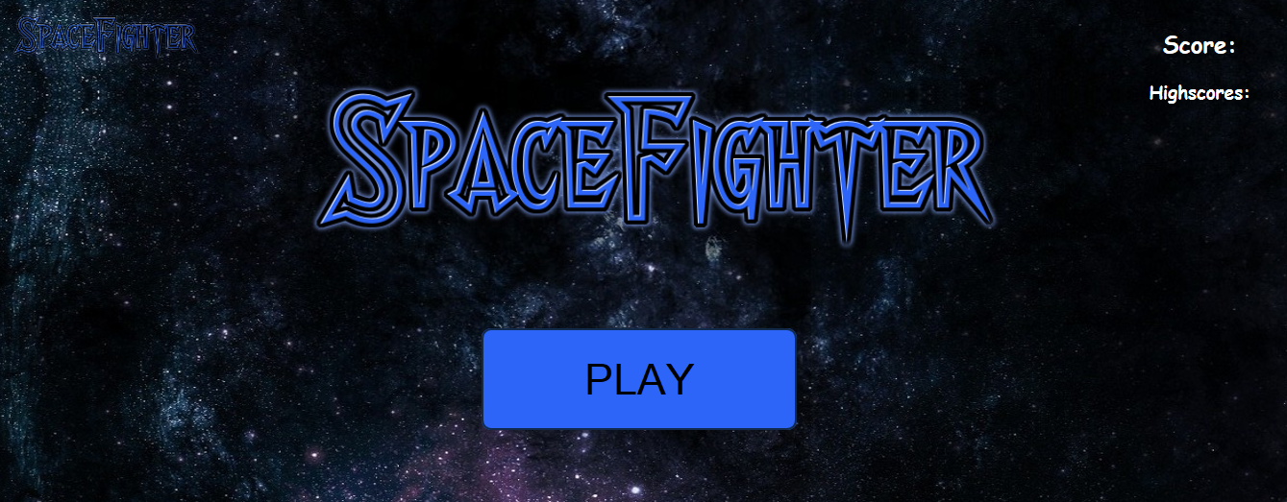
Live Demo

Slide 4
Questions ?

